Slide 1

Design-Think Your Life

Slide 2


Initiative & Attitude
You are proactive! You developed your soft skills for this class (session 3):
Autonomy & creativity: You read the ePortfolio resources on Moodle SHS & created a basic Wix (?) ePortfolio
Curiosity: You tried out a « career development » personality test https://www.truity.com/view/tests/personality-career
Networking: You joined LinkedIn

Slide 3



Slide 4
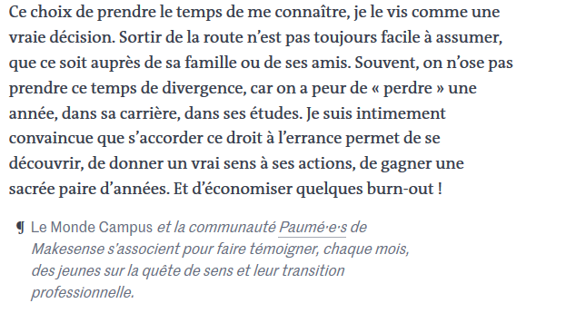

Slide 5
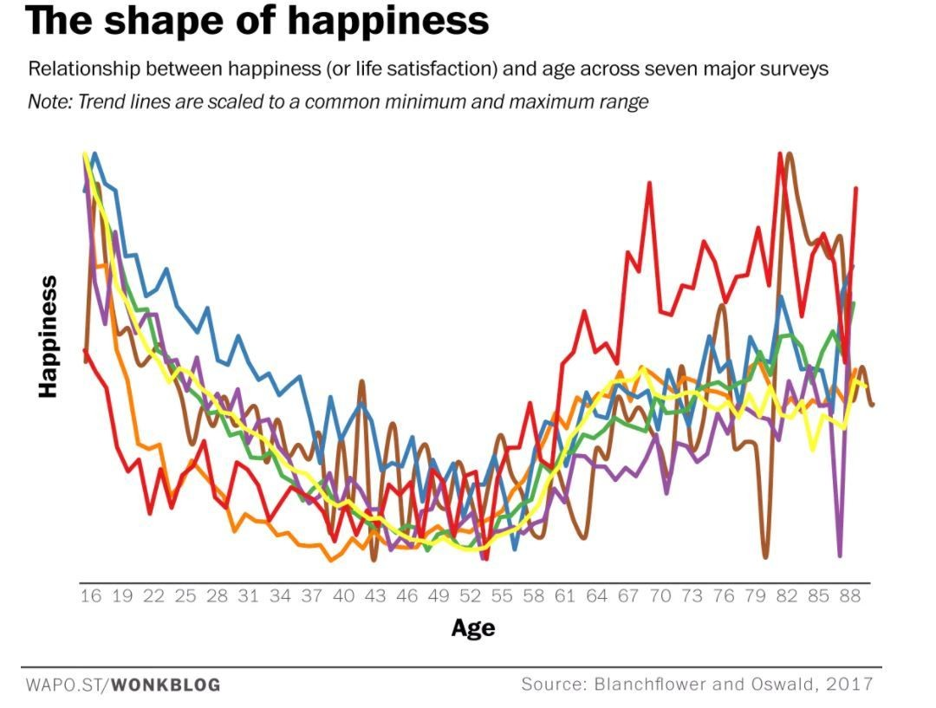

Take the time to
develop self-knowledge
design-think your life
build your life « fit »

Slide 6



Slide 7


January 2019: SHS N7 represents France (!) @Entrepreneurial Mindset Conference USA

Slide 8
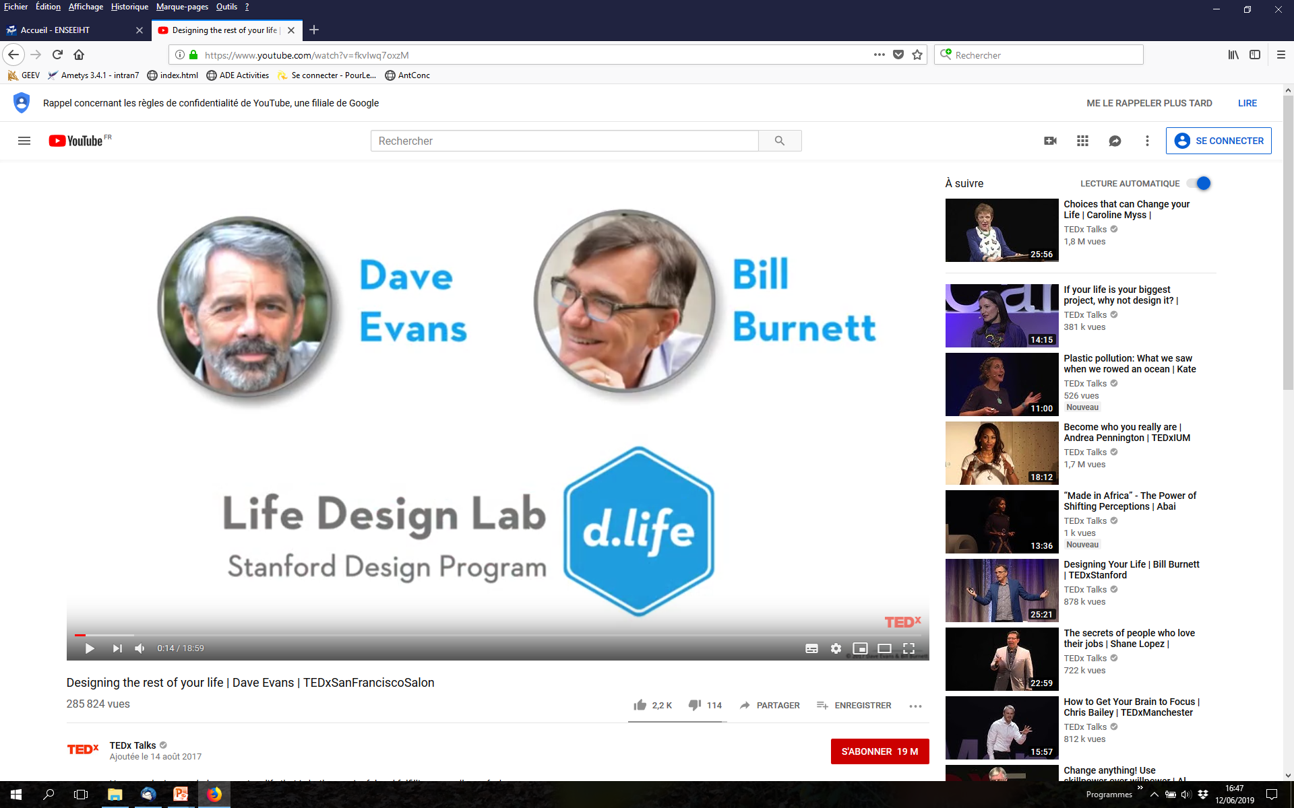
https://www.youtube.com/watch?v=fkvIwq7oxzM
https://www.youtube.com/watch?v=SemHh0n19LA

Slide 9

https://www.youtube.com/watch?v=fkvIwq7oxzM
https://www.youtube.com/watch?v=SemHh0n19LA

Slide 10
The Mission
The mission of d.life lab @
Stanford University:
« (…) class that helps you
figure out what you want to be
when you grow up. »

Slide 11
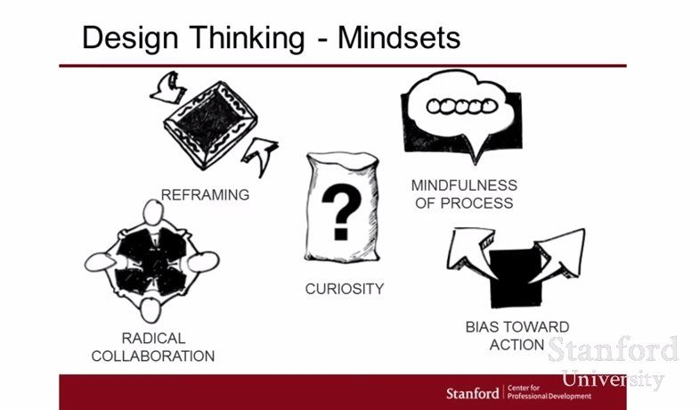
Design Thinking: a culture of mindsets
Source : https://www.google.com/search?q=design+thinking+mindsets&client=firefox-b&source=lnms&tbm=isch&sa=X&ved=0ahUKEwixmr6M7ujiAhVmAmMBHYypAHUQ_AUIECgB&biw=1920&bih=1035#imgrc=tRV_w6cYLcxBAM:

Slide 12


What kind of mindset* do you have?
* For more info. see Carol Dweck’s TED talk: https://www.ted.com/talks/carol_dweck_the_power_of_believing_that_you_can_improve/discussion

Slide 13

What kind of mindset do you have?
Find Kahoot on your phones :

Slide 14

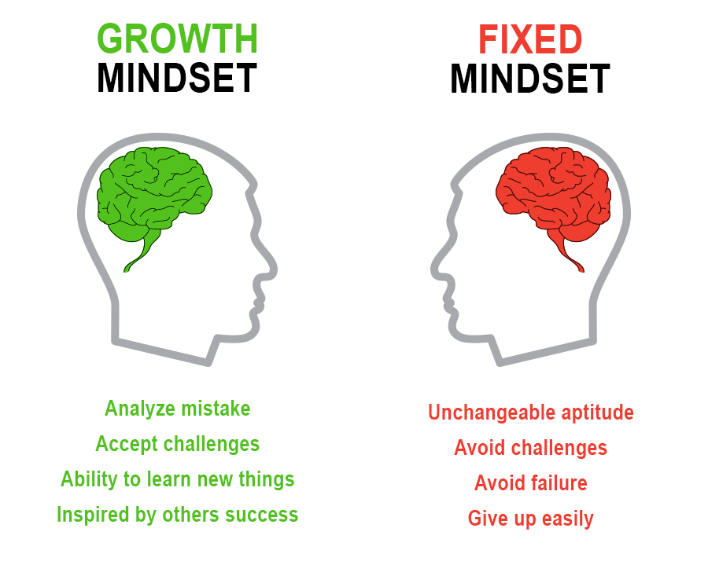
Mindset*
*Source: Carol Dweck, Stanford University, 2016

Slide 15
Mindset & N7 Students
Mindset ratio of 71 respondents (17%) of L3 N7 2018-2019

Slide 16
Design Thinking: a culture of mindsets
Source : https://www.google.com/search?q=design+thinking+mindsets&client=firefox-b&source=lnms&tbm=isch&sa=X&ved=0ahUKEwixmr6M7ujiAhVmAmMBHYypAHUQ_AUIECgB&biw=1920&bih=1035#imgrc=tRV_w6cYLcxBAM:

Slide 17

Which dysfunctional beliefs do you have?

Slide 18

Dysfunctional belief #1
What’s
your
passion ??

Slide 19

Dysfunctional belief #2
You should know where you’re going by now!
…And how to get there!

Slide 20

Dysfunctional belief #3
Be the best version of you!
Are you sure this is the ONE BEST LIFE?
Aren’t you worried that you are settling?

Slide 21

Dysfunctional beliefs dealt with.
Now what about constructive ideas?

Slide 22
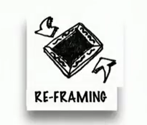
Idea #1: Connect the dots
What you believe
What you do
Who you are
Personal
life
Professional
life
Connecting the dots increases meaning-making

Slide 23

Idea #2: Gravity problems
If it’s not actionable,
it’s not a problem,
it’s a circumstance.
It’s called gravity!

Slide 24

Idea #3: How many lives are you?

Slide 25

Idea #3: How many lives are you?
There are lots of great versions of you!
It’s never too late!
Let’s start your odyssey!

Slide 26
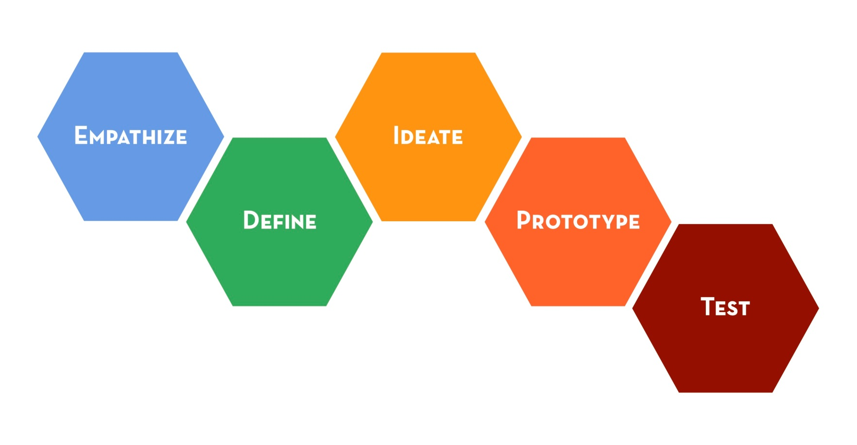
Design your odyssey: « ideate »!
Source: https://www.google.com/search?q=design+thinking&client=firefox-b&source=lnms&tbm=isch&sa=X&ved=0ahUKEwidvfTy7ujiAhVyA2MBHYABAsEQ_AUIECgB&biw=1920&bih=1035#imgrc=vuNSwWfNpuAsDM:

Slide 27


Ideate alternative futures
3 five-year odyssey plans (because there are lots of great versions of you!)

Slide 28
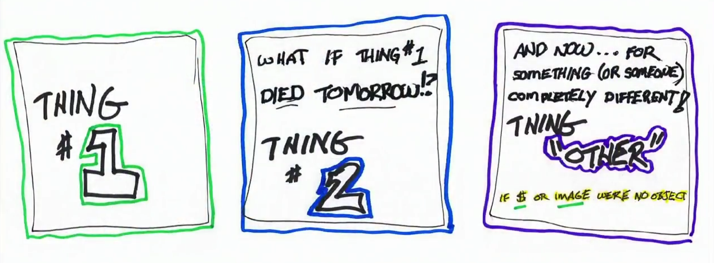
3 five-year versions of me??
Source: https://www.youtube.com/watch?v=SemHh0n19LA

Slide 29
Once you have some ideas,
then its time to…
Source: https://www.google.com/search?q=design+thinking&client=firefox-b&source=lnms&tbm=isch&sa=X&ved=0ahUKEwidvfTy7ujiAhVyA2MBHYABAsEQ_AUIECgB&biw=1920&bih=1035#imgrc=vuNSwWfNpuAsDM:

Slide 30


Idea #4: Prototyping
Prototype to:
ask interesting questions
expose assumptions
involve others with your ideas
sneak up on the future

Slide 31


Life design prototypes
Prototype conversations
Prototype experiences

Slide 32

Idea #5: Choosing well
The age-old question:
How do you know when you know?

Slide 33
Idea #5: Choosing well
Gather & Create
Narrow
down
Choose
Agonize
The process of choosing well

Slide 34
Idea #5: Choosing well
Gather & Create
Narrow
down
Choose
Agonize
The process of choosing well

Slide 35
Idea #5: Choosing well
Gather & Create
Narrow
down
Choose
Let go & move on
The process of choosing well

Slide 36
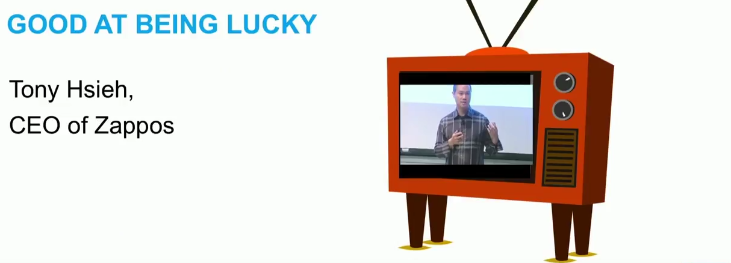
Idea #5: Choosing well
The process of choosing well
Source: https://www.youtube.com/watch?v=SemHh0n19LA

Slide 37



Idea #5: Choosing well
The process of choosing well
Gather & Create
Narrow
down
Choose
Let go
&
move on

Slide 38

Idea #5: Choosing well
The process of choosing well
Gather & Create
Narrow
down
Choose
Let go
&
move on
« The wisdom of the emotions is a real thing. »
Goleman, D. (2006).
Emotional intelligence. Bantam.

Slide 39

Idea #5: Choosing well
The process of choosing well
Gather & Create
Narrow
down
Choose
Let go & move on
« Wanting what you get » not
« Getting what you want »
Gilbert, D. (2009).
Stumbling on happiness. Vintage.

Slide 40
5 Design Thinking Ideas
…with you!
Connect
the dots –
do a
work & life
overview
…3 five
year
odyssey
plans
…gravity
problems
…your
life
…by assessing your choices
Source: https://www.google.com/search?q=design+thinking&client=firefox-b&source=lnms&tbm=isch&sa=X&ved=0ahUKEwidvfTy7ujiAhVyA2MBHYABAsEQ_AUIECgB&biw=1920&bih=1035#imgrc=vuNSwWfNpuAsDM:

Slide 41
Source : https://www.google.com/search?q=design+thinking+mindsets&client=firefox-b&source=lnms&tbm=isch&sa=X&ved=0ahUKEwixmr6M7ujiAhVmAmMBHYypAHUQ_AUIECgB&biw=1920&bih=1035#imgrc=tRV_w6cYLcxBAM:
To sum up:
Get curious
Talk to people
Try stuff

Slide 42

Initiative & Attitude
Be proactive! Develop your soft skills for next class (session 4):
Autonomy & creativity: Read the ePortfolio resources on Moodle SHS & create a basic Wix (?) ePortfolio
Curiosity: Try out a « career development » personality test https://www.truity.com/view/tests/personality-career
Networking: Join LinkedIn
Design Thinking your Life:
Complete the Journaling, Workview & Lifeview activities (pp.1-3)
Watch the TED Talks https://www.youtube.com/watch?v=SemHh0n19LA https://www.youtube.com/watch?v=fkvIwq7oxzM

